Slide 1
Translation project
Good translation
Bad translation
Direct translation
Language misunderstandings

Slide 2
Good translation
ลากรณีสมาชิกในครอบครัวเสียชีวิต
สมาชิกในครอบครัวคือบิดา-มารดา, สามี-ภรรยา, บุตรและธิดา ร่วมบิดามารดาเดียวกัน ลาได้ โดยใช้วันพักร้อน ส่งใบลาทันทีที่กลับมาทำงานพร้อมแนบสำเนาใบมรณะบัตร บริษัทฯจัดส่งพวงหรีดแสดงความอาลัย
Funeral leave
The employee shall be entitled to take time off work to attend the funeral of any of his family members such as his father, mother, brother, sister, spouse or child. The Company shall send a wreath to express its condolences. Upon return to work, the employee shall submit a leave request form and a photocopy of the decedent's death certificate. The employee's vacation entitlement shall be reduced by the number of days taken off to attend such funeral.

Slide 3
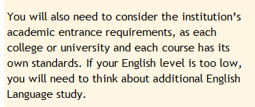
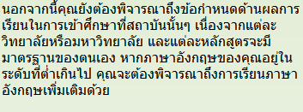
Good translation

Slide 4
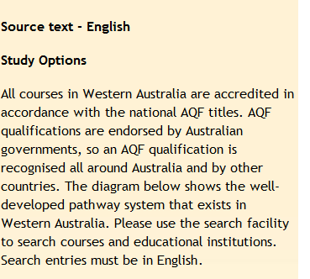
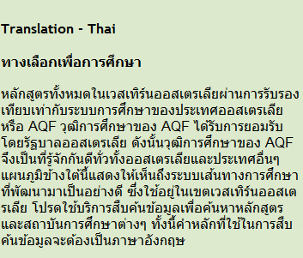
Good translation

Slide 5
Good translation
การสอบสวนชันสูตรพลิกศพเป็นความตายมิได้เป็นผลแห่งการกระทำผิดทางอาญา เห็นควรดำเนินการตามประมวลกฎหมายวิธีพิจารณาความอาญามาตรา 150 วรรคแรกต่อไป
The investigation and autopsy revealed that such death was not caused by any criminal acts. It is therefore appropriate that the case be dealt with pursuant to Paragraph One, Section 150, Criminal Procedure Code of Thailand.

Slide 6
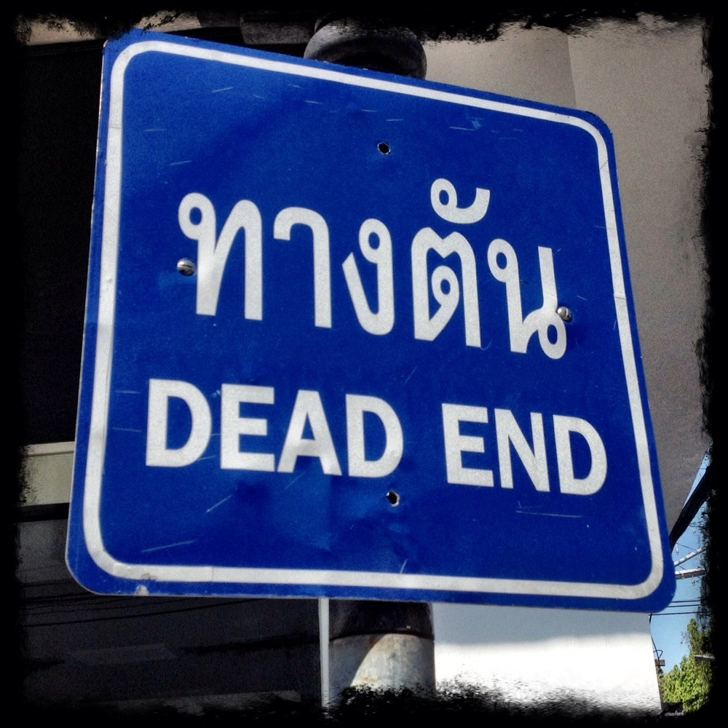
Good translation

Slide 7
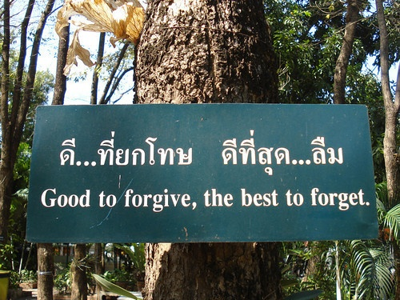
Good translation

Slide 8
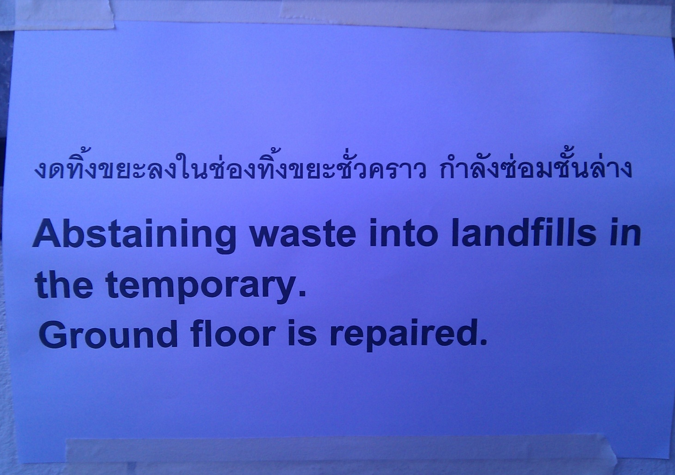
No littering, ground floor is under construction.
Bad translation

Slide 9
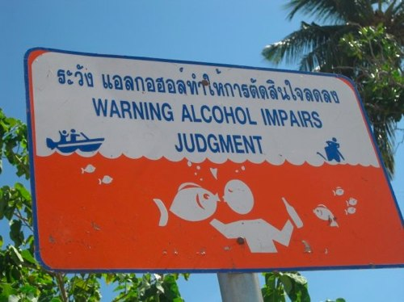
Alcohol can decrease the ability of making decision
Bad translation

Slide 10
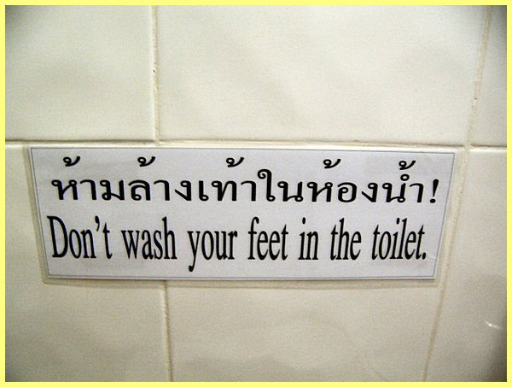
Bad translation
Do not wash your feet here!

Slide 11
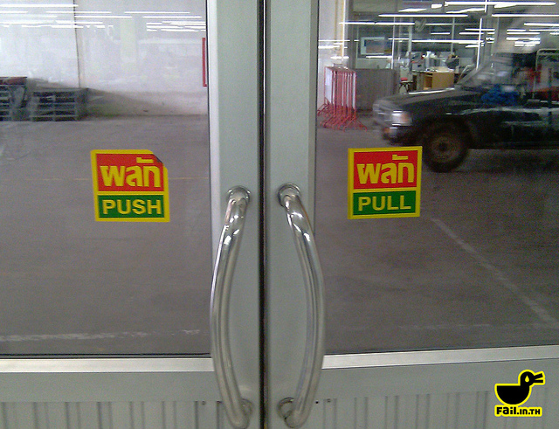
Bad translation
Push : ผลัก
Pull : ดึง

Slide 12
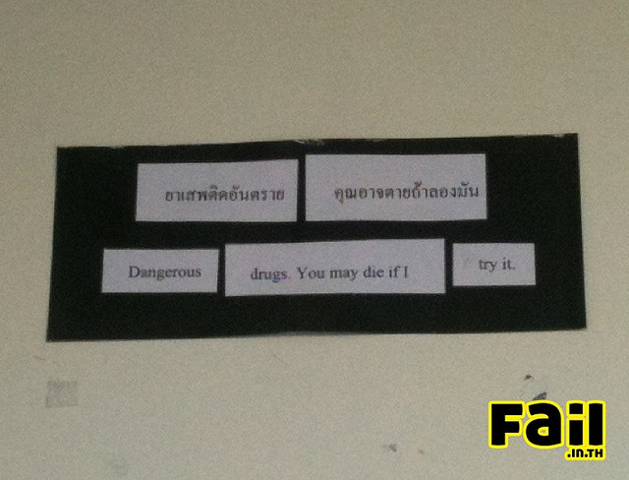
Bad translation
ยาเสพย์ติดอันตราย คุณอาจตายถ้าลองมัน
Addictive substance is dangerous to life.

Slide 13
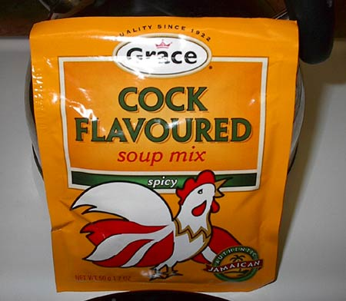
Bad translation
Chicken Flavoured

Slide 14
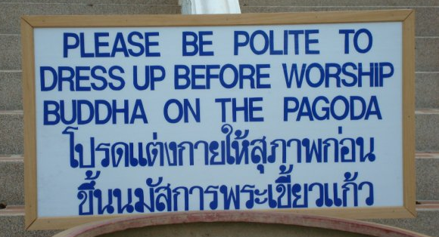
Please dress up properly before worshiping Buddha on the pagoda.
Bad translation

Slide 15
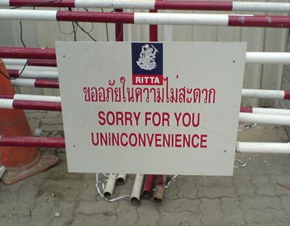
Sorry for the inconvenience.
We apologize for the inconvenience.
Bad translation

Slide 16

Buy the old furniture and second hand safe
Direct translation

Slide 17
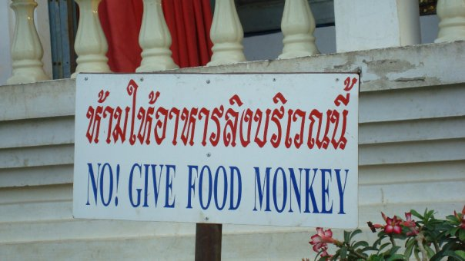
Direct translation
Do not feed the monkeys

Slide 18
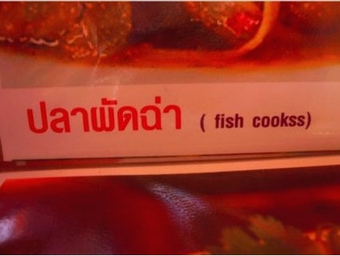
Direct translation
Thai stir-fried spicy fish

Slide 19
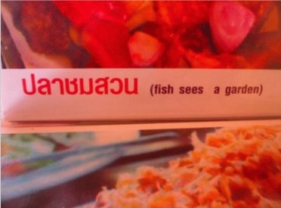
Direct translation
Deep fried fish with lemon spicy sauce and mixed herb

Slide 20
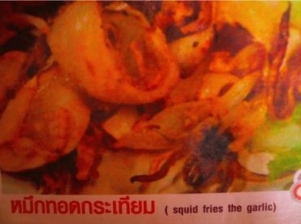
Direct translation
Fried squid with garlic and pepper

Slide 21
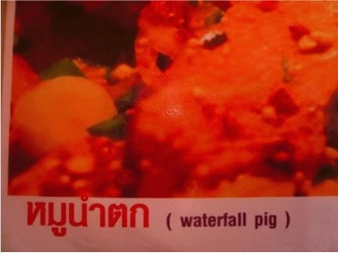
Direct translation
Grilled pork with spicy salad

Slide 22
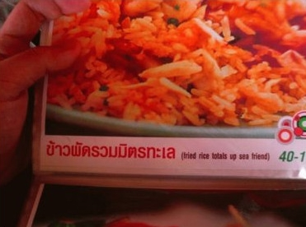
Direct translation
Seafood fried rice

Slide 23
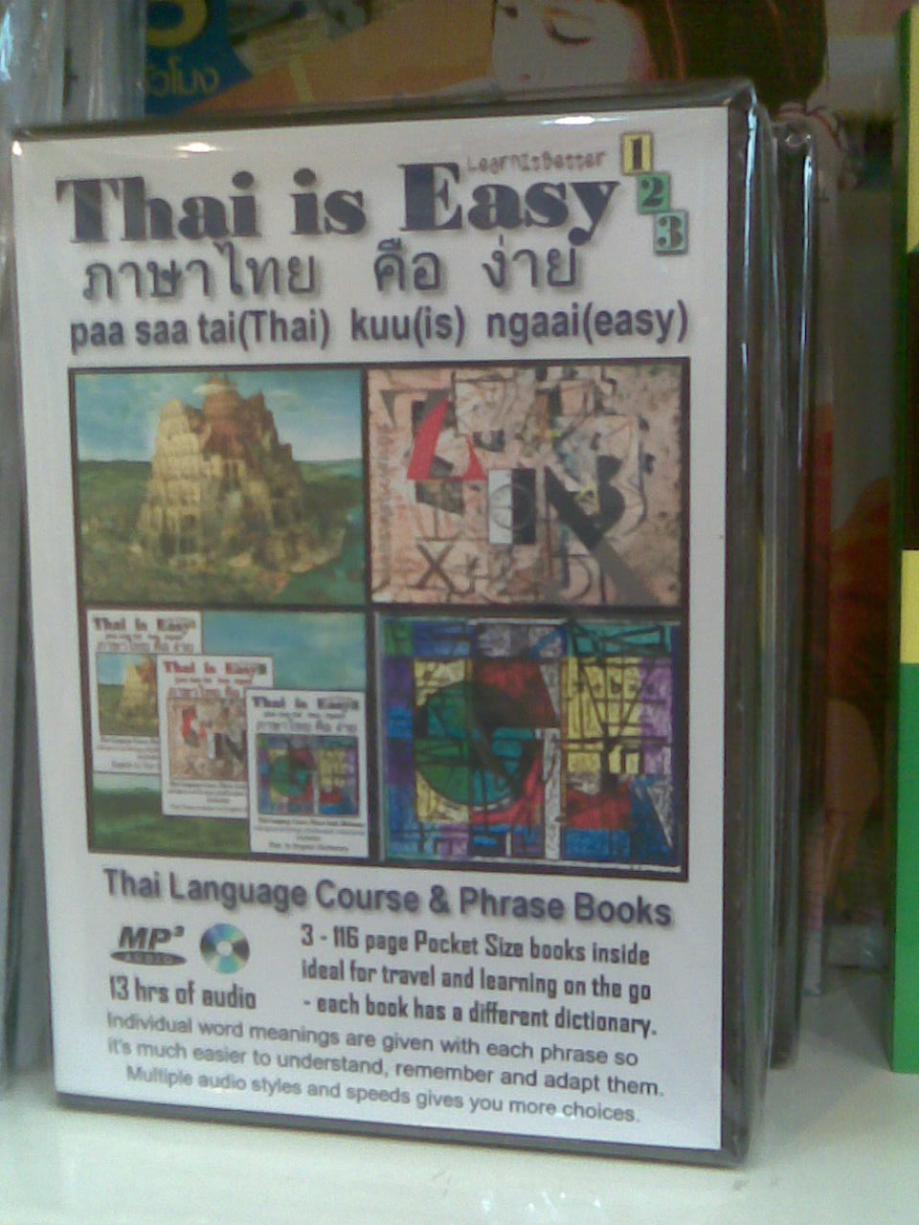
Direct translation
Thai is Easy: ภาษาไทยง่ายนิดเดียว

Slide 24
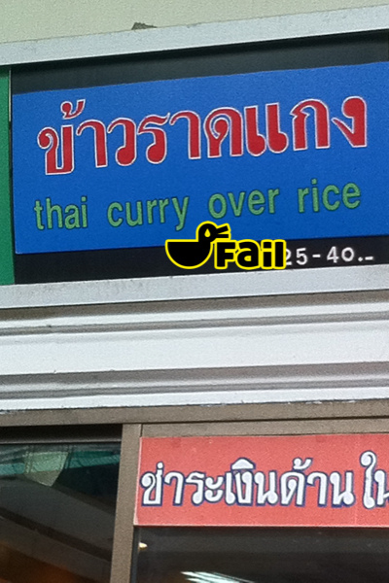
Direct translation
Rice and curry

Slide 25
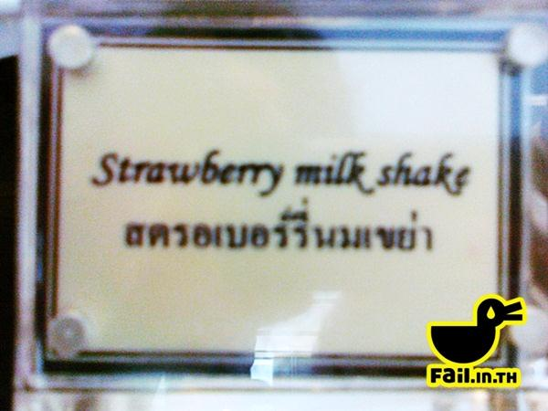
Direct translation
น้ำสตรอเบอรี่ปั่นใส่นม

Slide 26

Language Misunderstandings

Slide 27

Restroom
A : I have a bad stomachache, I need to go to the restroom now.
B : O.k., take some pills and rest in the restroom.
A : ?????

Slide 28

I am going
A Thai student was on a home stay with an American family. One day, the mother call her to have dinner. When she came downstairs to the kitchen, her mother said…
Mother: Dinner is ready! Thai student: Thanks, I’m going.
Mother: Don’t you have dinner with me???
(Thai student should say : “ I’m coming down soon”)

Slide 29
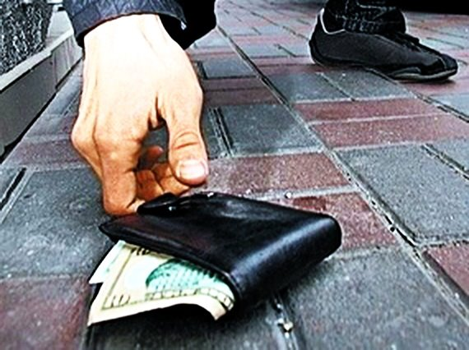
Hey you !
(A foreigner has dropped his wallet during walking in the store.)
Thai student: Hey you! Be careful! You dropped your wallet.
Farang: @#$*?!@@#$
" Hey you ! "
ในภาษาอังกฤษ คือ " เห้ย! มึง...มึงโว้ยมึง "
ซึ่งเป็นคำไม่สุภาพ ที่จริงควรจะพูดว่า : “Sir or Madam
Excuse me”

Slide 30
What do you want ?
When Thai speakers said this sentence, their intention is helping you.
The phrase “What do you want?” is considered to be impolite. Foreigners may think you want to fight with them.
The polite phrase that can also be used in this context is “May I help you?”
“What can I do for you?”
“Do you want some help?”

Slide 31
Never mind
In Thai culture, when we want to comfort someone from their suffering, we usually say “ไม่เป็นไรนะ”
In Western culture, the phrase “Never mind” is used when someone say “Sorry!” and you response her with “Never mind”
If you want to comfort someone, you should use “Take it easy”

Slide 32
Just keep it
In the temple, a monk teach foreigners about five percepts.
“It is difficult to keep all five percepts, just keep one.”

Slide 33
Just keep it
A monk does not mean that you can keep only one percept instead of five, since it is too difficult.
The appropriate phrase to use is
“It is difficult to keep all five percepts, but try as best as you can”

Slide 34
Members
1. Chuthamat Khrueapaeng 530110014
2. Jettarin Kaewkamnerd 530110016
3. Nudpawee Choncharoen 530110043
4. Mekdang Udomsri 530110066

